Slide 1
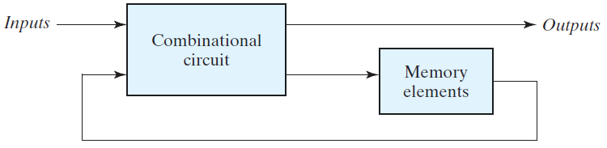
Unit-3: Sequential Logic Circuits
Introduction:
The digital circuits considered thus far have been combinational—their output depends only and immediately on their inputs—they have no memory, i.e., dependence on past values of their inputs. Sequential circuits, however, act as storage elements and have memory. They can store, retain, and then retrieve information when needed at a later time.
Sequential circuits:
A block diagram of a sequential circuit is shown in the following Fig. It consists of a combinational circuit to which storage elements are connected to form a feedback path.

Slide 2
The block diagram demonstrates that the outputs in a sequential circuit are a function not only of the inputs, but also of the present state of the storage elements. The next state of the storage elements is also a function of external inputs and the present state. Thus, a sequential circuit is specified by a time sequence of inputs, outputs, and internal states. In contrast, the outputs of combinational logic depend only on the present values of the inputs.
There are two main types of sequential circuits, and their classification is a function of the timing of their signals. A synchronous sequential circuit is a system whose behavior can be defined from the knowledge of its signals at discrete instants of time. The behavior of an asynchronous sequential circuit depends upon the input signals at any instant of time and the order in which the inputs change.

Slide 3
Synchronous sequential circuits that use clock pulses to control storage elements are called clocked sequential circuits and are the type most frequently encountered in practice. They are called synchronous circuits because the activity within the circuit and the resulting updating of stored values is synchronized to the occurrence of clock pulses.
The storage elements (memory) used in clocked sequential circuits are called flip flops. A flip-flop is a binary storage device capable of storing one bit of information. In a stable state, the output of a flip-flop is either 0 or 1. The block diagram of a synchronous clocked sequential circuit is shown in the following Fig. A change in state of the flip-flops is initiated only by a clock pulse transition—for example, when the value of the clock signals changes from 0 to 1.
The transition from one state to the next occurs only at predetermined intervals dictated by the clock pulses.

Slide 4
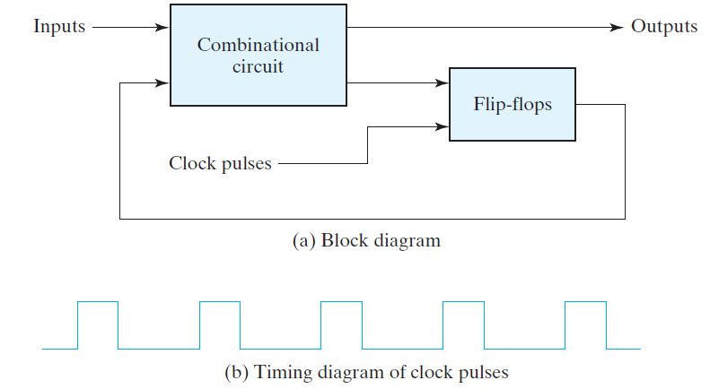

Slide 5
STORAGE ELEMENTS : LATCHES
Storage elements that operate with signal levels (rather than signal transitions) are referred to as latches ; those controlled by a clock transition are flip-flops.
Latches are said to be level sensitive devices; flip-flops are edge-sensitive devices.
SR Latch:
The SR latch is a circuit with two cross-coupled NOR gates or two cross-coupled NAND gates, and two inputs labeled S for set and R for reset. The SR latch constructed with two cross-coupled NOR gates is shown in the following Fig. The latch has two useful states. When output Q = 1 and Q’ = 0, the latch is said to be in the set state . When Q = 0 and Q’= 1, it is in the reset state. Outputs Q and Q’ are normally the complement of each other. However, when both inputs are equal to 1 at the same time, a condition in which both outputs are equal to 0 (rather than be mutually complementary) occurs.

Slide 6
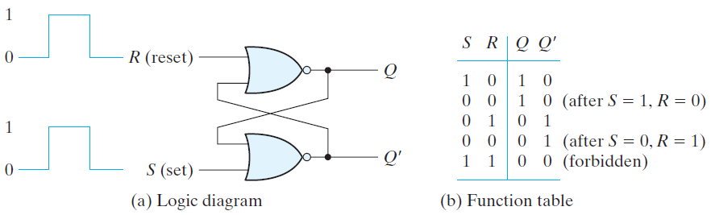
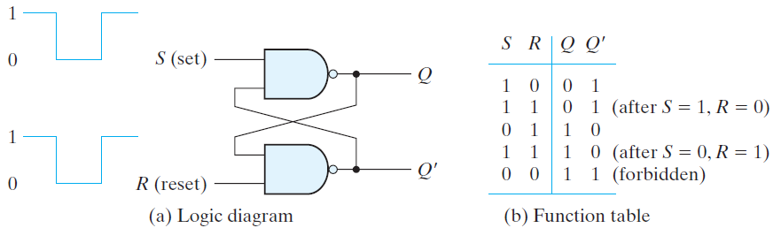

Slide 7
In comparing the NAND with the NOR latch, note that the input signals for the NAND require the complement of those values used for the NOR latch. Because the NAND latch requires a 0 signal to change its state, it is sometimes referred to as an S’R’ latch.
An SR latch with a control (enable) input is shown in the following Fig. It consists of the basic SR latch and two additional NAND gates. The control input En acts as an enable signal for the other two inputs. The outputs of the NAND gates stay at the logic-1 level as long as the enable signal remains at 0. This is the quiescent condition for the SR latch. When the enable input goes to 1, information from the S or R input is allowed to affect the latch.

Slide 8
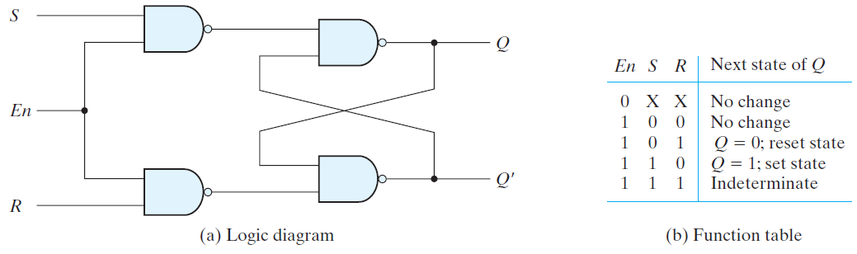
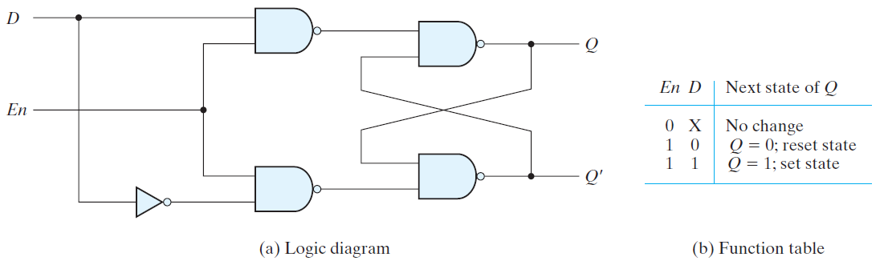
D Latch (Transparent Latch):

Slide 9
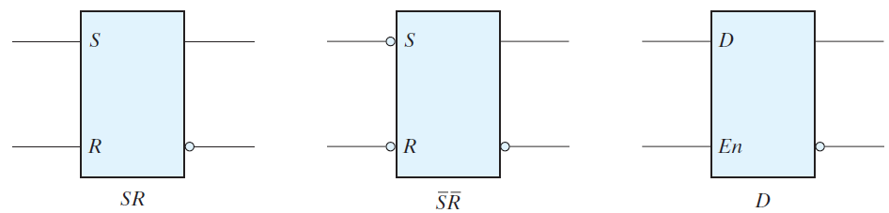
The graphic symbols for the various latches are shown in the following Fig.
STORAGE ELEMENTS : FLIP – FLOPS:
The problem with the latch is that it responds to a change in the level of a clock pulse. As shown in the following Fig., a positive level response in the enable input allows changes in the output when the D input changes while the clock pulse stays at logic 1.
The key to the proper operation of a flip-flop is to trigger it only during a signal transition.

Slide 10
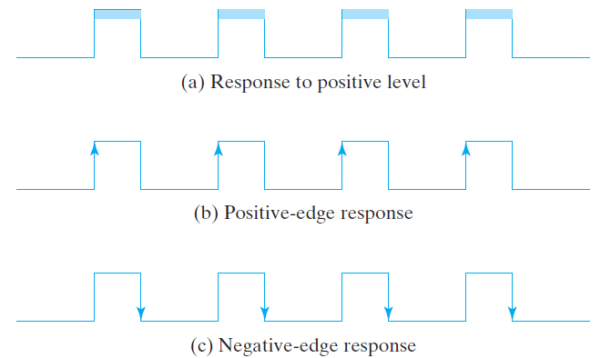
There are two ways that a latch can be modified to form a flip-flop. One way is to employ two latches in a special configuration that isolates the output of the flip-flop and prevents it from being affected while the input to the flip-flop is changing (master-slave flip flop).

Slide 11
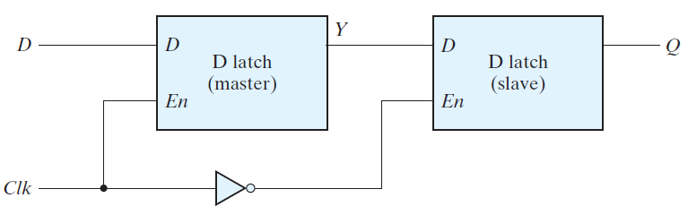
Another way is to produce a flip-flop that triggers only during a signal transition (from 0 to 1 or from 1 to 0) of the synchronizing signal (clock) and is disabled during the rest of the clock pulse (edge triggered flip flop).
Master–slave D flip-flop:
FIGURE: Master–slave D flip-flop
A change in the output of the flip-flop can be triggered only by and during the transition of the clock from 1 to 0.

Slide 12
The behavior of the master–slave flip-flop just described dictates that (1) the output may change only once, (2) a change in the output is triggered by the negative edge of the clock, and (3) the change may occur only during the clock’s negative level.
The value that is produced at the output of the flip-flop is the value that was stored in the master stage immediately before the negative edge occurred.
Home work
It is also possible to design the circuit so that the flip-flop output changes on the positive edge of the clock. (How?)

Slide 13
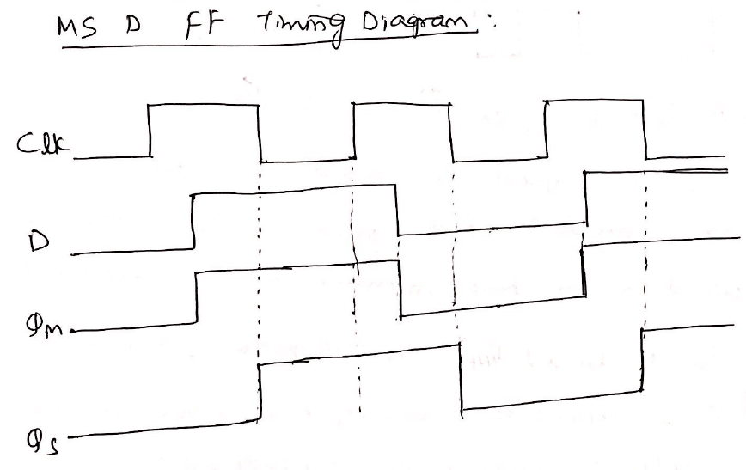

Slide 14
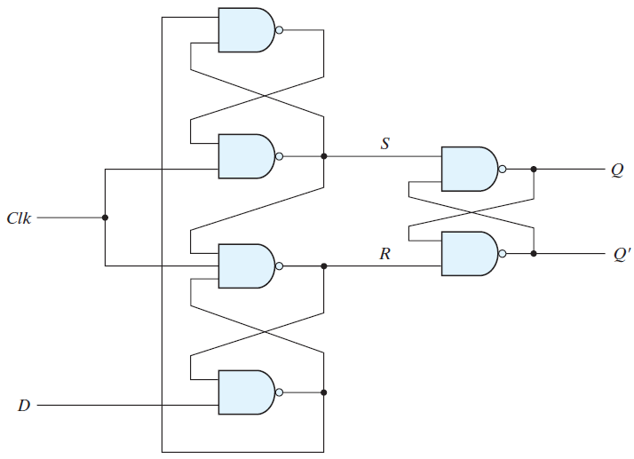
D -type positive-edge-triggered flip-flop:
FIGURE: D -type positive-edge-triggered flip-flop

Slide 15
In summary, when the input clock in the positive-edge-triggered flip-flop makes a positive transition, the value of D is transferred to Q .
A negative transition of the clock (i.e., from 1 to 0) does not affect the output, nor is the output affected by changes in D when Clk is in the steady logic-1 level or the logic-0 level. Hence, this type of flip-flop responds to the transition from 0 to 1 and nothing else.
There is a minimum time called the setup time during which the D input must be maintained at a constant value prior to the occurrence of the clock transition. Similarly, there is a minimum time called the hold time during which the D input must not change after the application of the positive or negative transition of the clock.
The propagation delay time of the flip-flop is defined as the interval between the trigger edge and the stabilization of the output to a new state.

Slide 16
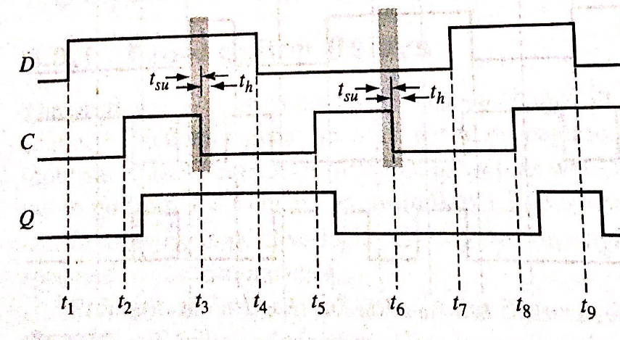

Slide 17
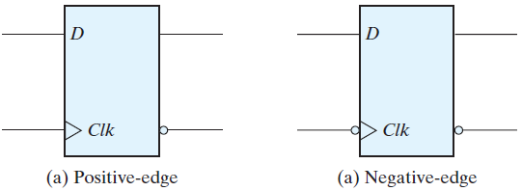
Graphic symbol for edge-triggered D flip-flop:
The graphic symbol for the edge-triggered D flip-flop is shown in the above Fig.
It is similar to the symbol used for the D latch, except for the arrowhead-like symbol in front of the letter Clk, designating a dynamic input. The dynamic indicator (>) denotes the fact that the flip-flop responds to the edge transition of the clock.

Slide 18
Direct Inputs: D flip-flop with asynchronous reset:
Some flip-flops have asynchronous inputs that are used to force the flip-flop to a particular state independently of the clock. The input that sets the flip-flop to 1 is called preset or direct set . The input that clears the flip-flop to 0 is called clear or direct reset. When power is turned on in a digital system, the state of the flip-flops is unknown. The direct inputs are useful for bringing all flip-flops in the system to a known starting state prior to the clocked operation.
A positive-edge-triggered D flip-flop with active-low asynchronous reset is shown in the following Fig. The circuit diagram is the same as positive edge triggered D FF, except for the additional reset input connections to three NAND gates. When the reset input is 0, it forces output Q’ to stay at 1, which, in turn, clears output Q to 0, thus resetting the flip-flop.

Slide 19
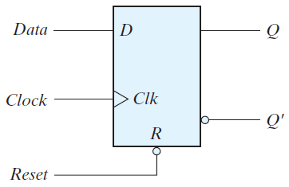
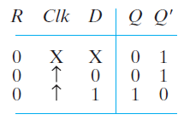
Two other connections from the reset input ensure that the S input of the third SR latch stays at logic 1 while the reset input is at 0, regardless of the values of D and Clk.
Flip-flops with a direct set use the symbol S for the asynchronous set input.
When R = 0, the output is reset to 0. This state is independent of the values of D or Clk . Normal clock operation can proceed only after the reset input goes to logic 1. The clock at Clk is shown with an upward arrow to indicate that the flip-flop triggers on the positive edge of the clock. The value in D is transferred to Q with every positive-edge clock signal, provided that R = 1.

Slide 20
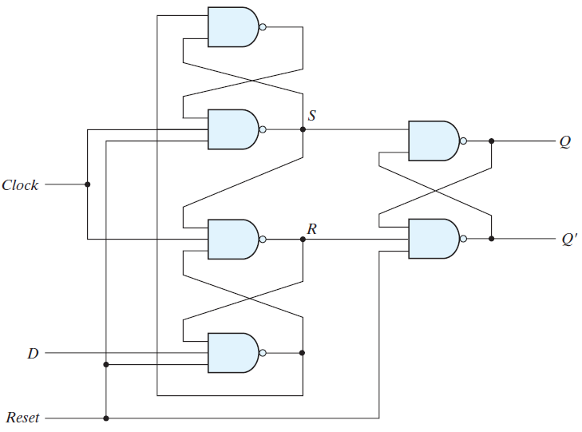
FIGURE: D flip-flop with asynchronous reset

Slide 21
Other Flip-Flops:
Each flip-flop is constructed from an interconnection of gates.
The most economical and efficient flip-flop constructed in this manner is the edge-triggered D flipflop, because it requires the smallest number of gates.
Other types of flip-flops can be constructed by using the D flip-flop and external logic.
Two flip-flops less widely used in the design of digital systems are the JK and T flip-flops.
There are three operations that can be performed with a flip-flop: Set it to 1, reset it to 0, or complement its output.

Slide 22

With only a single input, the D flip-flop can set or reset the output, depending on the value of the D input immediately before the clock transition.
Synchronized by a clock signal, the JK flip-flop has two inputs and performs all three operations. The circuit diagram of a JK flip-flop constructed with a D flip-flop and gates is shown in the following Fig.
The J input sets the flip-flop to 1, the K input resets it to 0, and when both inputs are enabled, the output is complemented.
This can be verified by investigating the circuit applied to the D input:
JK flip-flop:

Slide 23
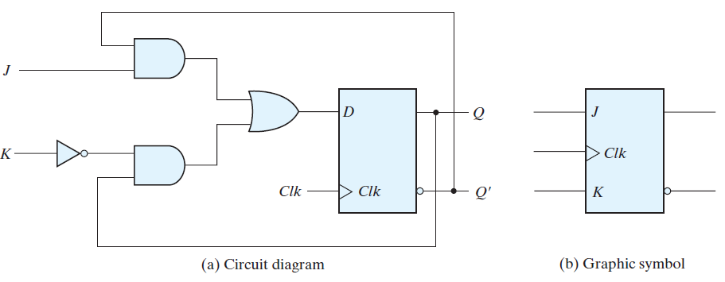
FIGURE : JK flip-flop

Slide 24
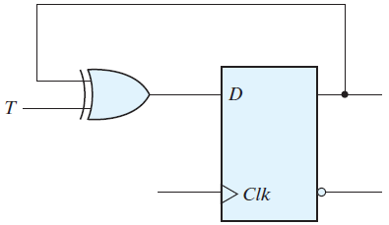
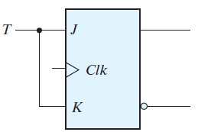
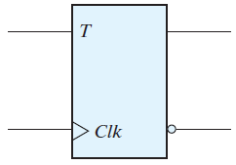

The T (toggle) flip-flop:
It is a complementing flip-flop and can be obtained from a JK flip-flop when inputs J and K are tied together as shown in the following Fig.
(a) From JK flip-flop
(b) From D flip-flop
(c) Graphic symbol
The T flip-flop can also be constructed with a D flip-flop and an exclusive-OR gate as shown in Fig. (b).
The expression for the D input is

Slide 25
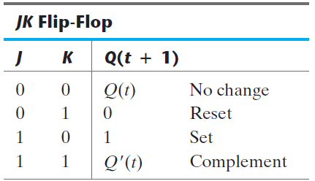
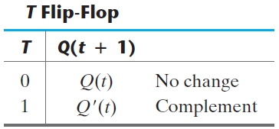
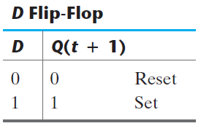
Characteristic Tables:
A characteristic table defines the logical properties of a flip-flop by describing its operation in tabular form. They define the next state (i.e., the state that results from a clock transition) as a function of the inputs and the present state.

Slide 26


Characteristic Equations:
The logical properties of a flip-flop, as described in the characteristic table, can be expressed algebraically with a characteristic equation.
For the D flip-flop, we have the characteristic equation:
The characteristic equation for the JK flip-flop:
The characteristic equation for the T flip-flop:

Slide 27
ANALYSIS OF CLOCKED SEQUENTIAL CIRCUITS:
Analysis describes what a given circuit will do under certain operating conditions. The behavior of a clocked sequential circuit is determined from the inputs, the outputs, and the state of its flip-flops.
The outputs and the next state are both a function of the inputs and the present state. The analysis of a sequential circuit consists of obtaining a table or a diagram for the time sequence of inputs, outputs, and internal states.
Here an algebraic expression is written for specifying the next-state condition in terms of the present state and inputs.
A state table and state diagram are then presented to describe the behavior of the sequential circuit.
Another algebraic representation is introduced for specifying the logic diagram of sequential circuits.

Slide 28
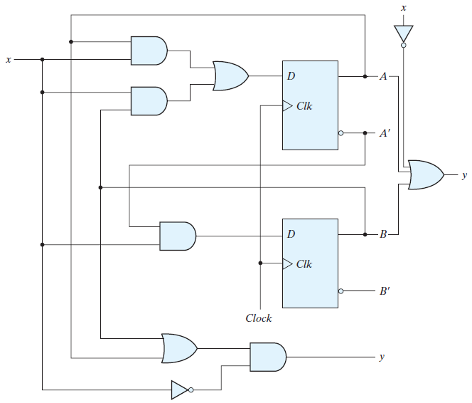
State Equations:

Slide 29

The behavior of a clocked sequential circuit can be described algebraically by means of state equations. A state equation (also called a transition equation ) specifies the next state as a function of the present state and inputs.
It consists of two D flip-flops A and B, an input x and an output y. Since the D input of a flip-flop determines the value of the next state (i.e., the state reached after the clock transition), it is possible to write a set of state equations for the circuit:
A(t + 1) = Ax + Bx
B(t + 1) = A’x
Similarly, the present-state value of the output can be expressed algebraically as
y = (A + B)x’

Slide 30
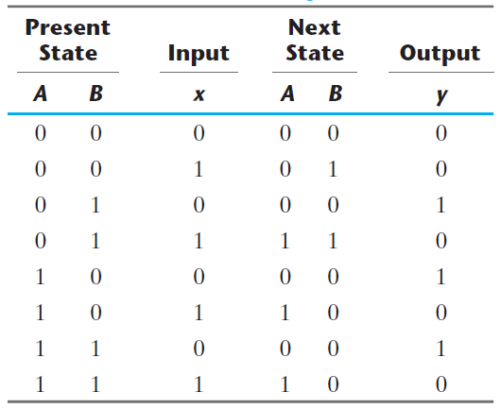
State Table or Transition Table:
The time sequence of inputs, outputs, and flip-flop states can be enumerated in a state table (sometimes called a transition table). This table consists of four sections labeled present state, input, next state, and output. The present-state section shows the states of flip-flops A and B at any given time t.

Slide 31
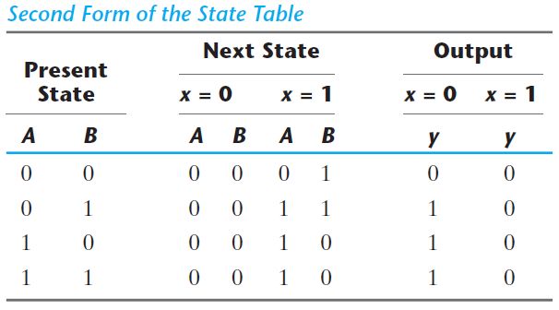
State Diagram:
The information available in a state table can be represented graphically in the form of a state diagram.
In this type of diagram, a state is represented by a circle, and the (clock-triggered) transitions between states are indicated by directed lines connecting the circles.

Slide 32
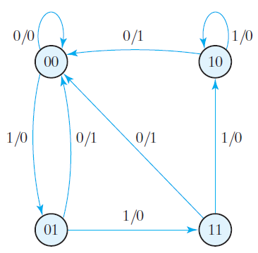
FIGURE: State diagram
The state diagram provides the same information as the state table and is obtained directly from State Table.
The steps presented in this example are summarized below:
Circuit diagram – Equations – State table - State diagram

Slide 33

Flip-Flop Input Equations:
The logic diagram of a sequential circuit consists of flip-flops and gates. The interconnections among the gates form a combinational circuit and may be specified algebraically with Boolean expressions.
The part of the combinational circuit that generates external outputs is described algebraically by a set of Boolean functions called output equations.
The part of the circuit that generates the inputs to flip-flops is described algebraically by a set of Boolean functions called flip-flop input equations (or, sometimes, excitation equations).
Analysis with D Flip-Flops:
Example: Write the circuit diagram, state table and state diagram for the following input equation:

Slide 34
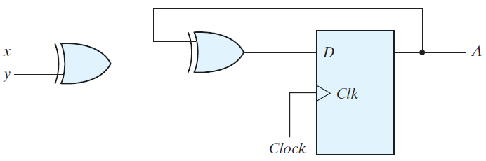
The DA symbol implies a D flip-flop with output A. The x and y variables are the inputs to the circuit.
No output equations are given, which implies that the output comes from the output of the flip-flop. The logic diagram is obtained from the input equation and is drawn in the following Fig.
The state table has one column for the present state of flip-flop A, two columns for the two inputs, and one column for the next state of A .

Slide 35

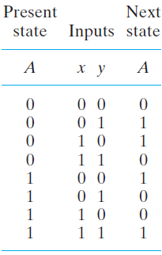
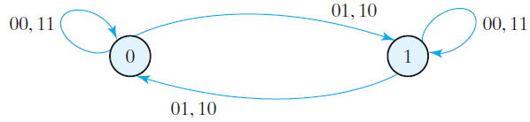
The next-state values are obtained from the state equation
The circuit has one flip-flop and two states. The state diagram consists of two circles, one for each state as shown in Fig.

Slide 36
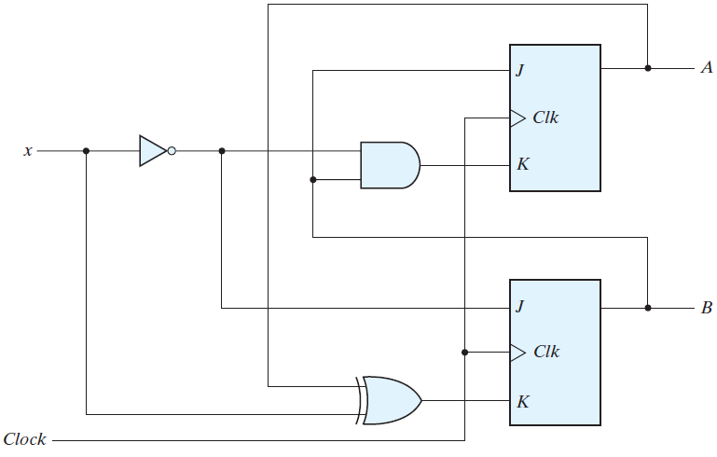
Analysis with JK Flip-Flops:
Consider the sequential circuit with two JK flip-flops A and B and one input x, as shown in the following Fig.
FIGURE: Sequential circuit with JK flip-flop

Slide 37

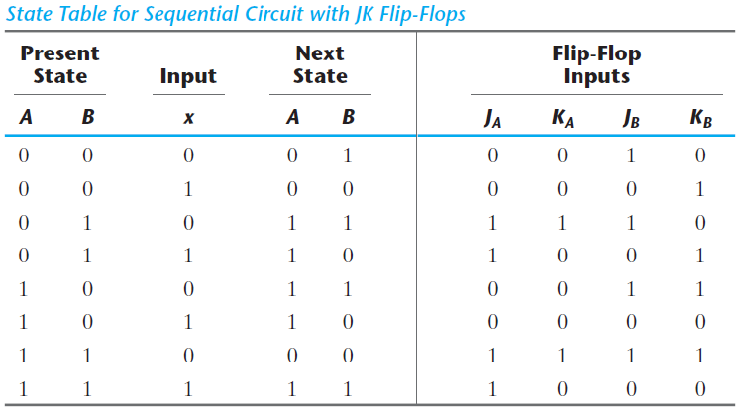
The circuit can be specified by the flip-flop input equations
The state table of the sequential circuit is shown in the following Table (using the characteristic table or equations)

Slide 38
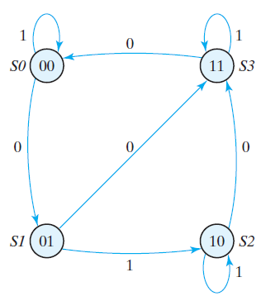
The state diagram of the sequential circuit is shown in the following Fig.

Slide 39
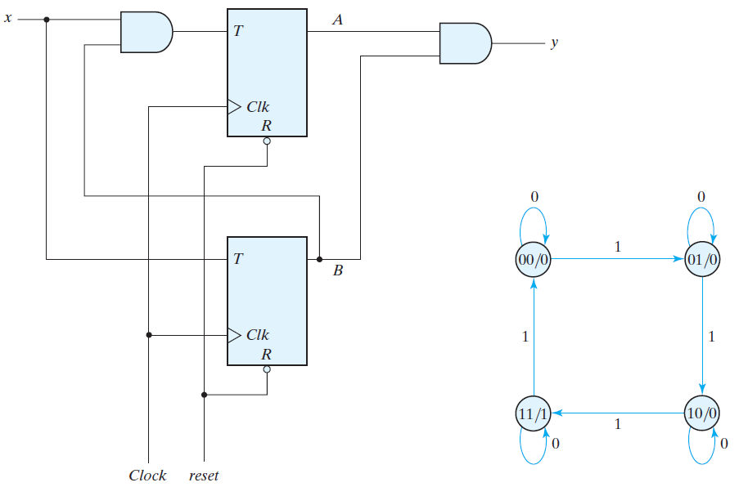
Analysis with T Flip-Flops:

Slide 40
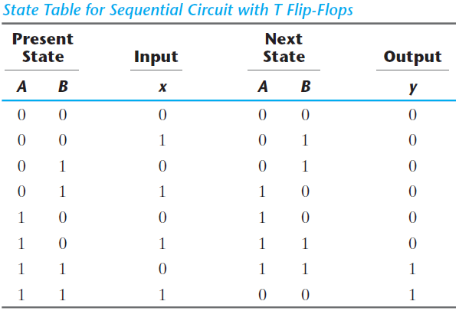
Here, the output depends on the present state only and is independent of the input.
The two values inside each circle and separated by a slash are for the present state and output.

Slide 41
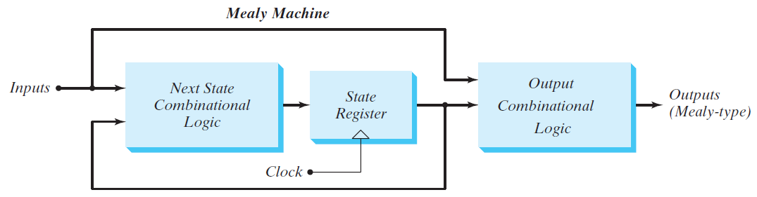
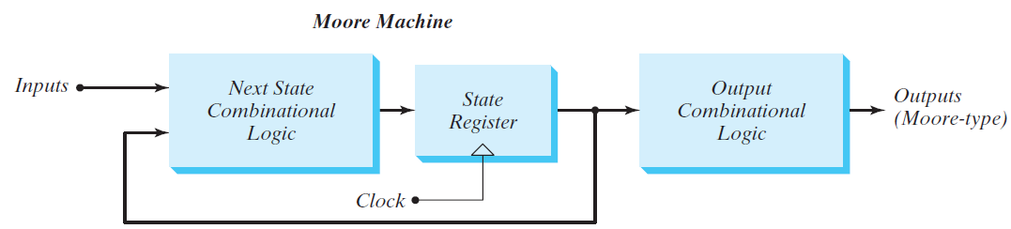
Mealy and Moore Models of Finite State Machines:
It is customary to distinguish between two models of sequential circuits: the Mealy model and the Moore model. Both are shown in Fig.

Slide 42
They differ only in the way the output is generated.
In the Mealy model, the output is a function of both the present state and the input.
In the Moore model, the output is a function of only the present state. A circuit may have both types of outputs. The two models of a sequential circuit are commonly referred to as a finite state machine, abbreviated FSM. The Mealy model of a sequential circuit is referred to as a Mealy FSM or Mealy machine. The Moore model is referred to as a Moore FSM or Moore machine.
In a Moore model, the outputs of the sequential circuit are synchronized with the clock, because they depend only on flip-flop outputs that are synchronized with the clock.
In a Mealy model, the outputs may change if the inputs change during the clock cycle.

Slide 43
Verilog Models of SLC:
Behavioral models are abstract representations of the functionality of digital hardware. That is, they describe how a circuit behaves, but don’t specify the internal details of the circuit.
Behavioral Modeling
There are two kinds of abstract behaviors in the Verilog HDL. Behavior declared by the keyword initial is called single-pass behavior and specifies a single statement or a block statement (i.e., a list of statements enclosed by either a begin . . . end or a fork . . . join keyword pair).
A single-pass behavior expires after the associated statement executes. The always keyword declares a cyclic behavior. Both types of behaviors begin executing when the simulator launches at time t = 0.
The initial behavior expires after its statement executes; the always behavior executes and reexecutes indefinitely, until the simulation is stopped.

Slide 44
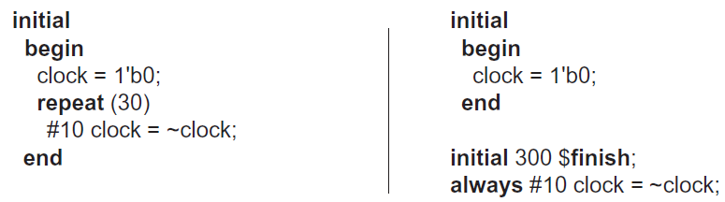
An initial behavioral statement executes only once. It begins its execution at the start of simulation and expires after all of its statements have completed execution.
The following are two possible ways to provide a free-running clock that operates for a specified number of cycles:
Here is another way to describe a free-running clock:
Time delays specified with the # delay control operator are commonly used in single-pass behaviors. The delay control operator suspends execution of statements until a specified time has elapsed.

Slide 45
Another operator @ is called the event control operator and is used to suspend activity until an event occurs. An event can be an unconditional change in a signal value (e.g., @ A) or a specified transition of a signal value (e.g., @ (posedge clock)).
The general form of this type of statement is:
always @ (event control expression) begin
// Procedural assignment statements that execute when the condition is met
end
The event control expression specifies the condition that must occur to launch execution of the procedural assignment statements.
The variables in the left-hand side of the procedural statements must be of the reg data type. The right-hand side can be any expression that produces a value using Verilog-defined operators.

Slide 46
always @ (A or B or C)
will initiate execution of the procedural statements in the associated always block if a change occurs in A, B, or C . In synchronous sequential circuits, changes in flip-flops occur only in response to a transition of a clock pulse.
always @(posedge clock or negedge reset) // Verilog 1995
always @(posedge clock, negedge reset) // Verilog 2001, 2005
A procedural assignment is an assignment of a logic value to a variable within an initial or always statement. This is in contrast to a continuous assignment.
There are two kinds of procedural assignments: blocking and nonblocking. The two are distinguished by the symbols that they use. Blocking assignments use the symbol (=) as the assignment operator, and nonblocking assignments use (< =) as the operator.

Slide 47
Blocking assignment statements are executed sequentially in the order they are listed in a block of statements. Nonblocking assignments are executed concurrently by evaluating the set of expressions on the right-hand side of the list of statements; they do not make assignments to their left-hand sides until all of the expressions are evaluated.
B = A
C = B + 1
Now consider the two statements as nonblocking assignments:
B <= A
C <= B + 1
A general rule is to use blocking assignments when sequential ordering is imperative and in cyclic behavior that is level sensitive (i.e., in combinational logic). Use nonblocking assignments when modeling concurrent execution (e.g., edge-sensitive behavior such as synchronous, concurrent register transfers) and when modeling latched behavior .

Slide 48
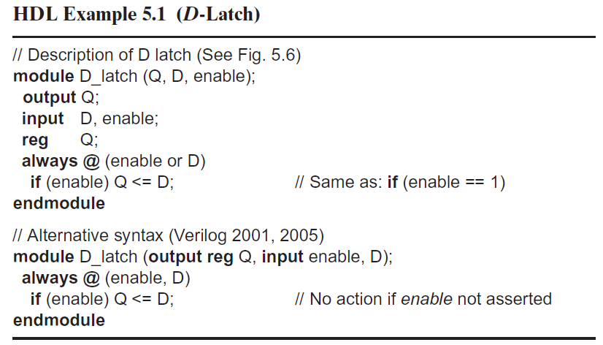
HDL Models of Flip-Flops and Latches:

Slide 49
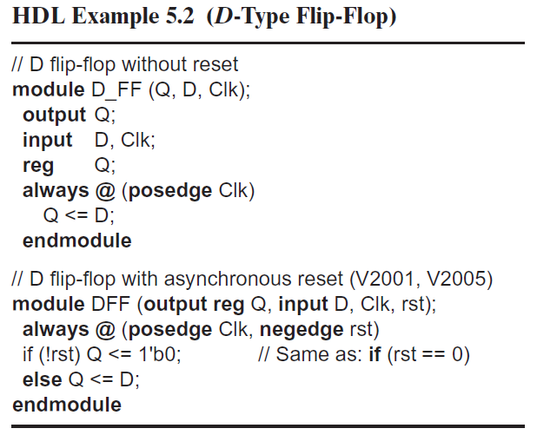

Slide 50
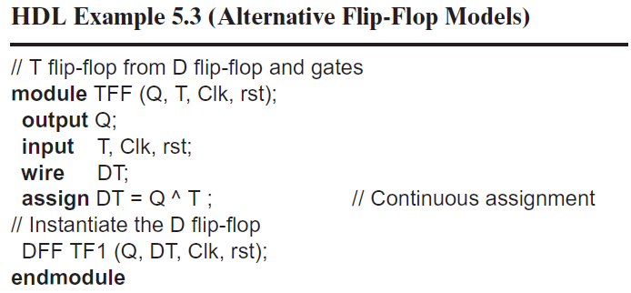

Slide 51
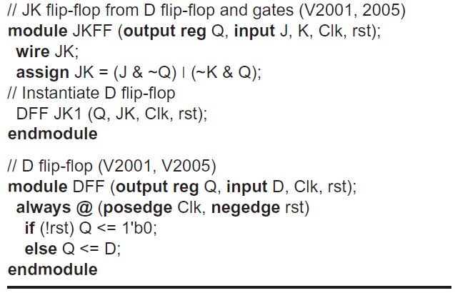

Slide 52
